Slide 1
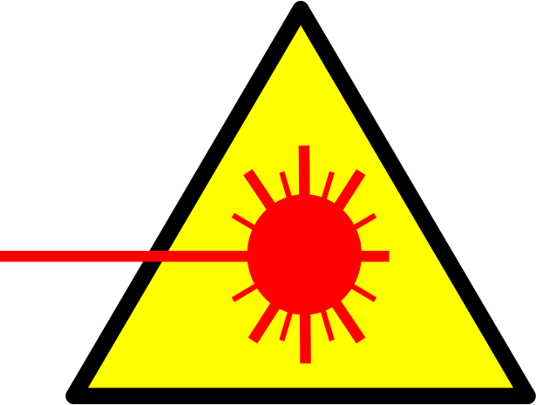
WARNING
!
CLASS 3B LASER AREA
Avoid eye or skin exposure to direct radiation.
Laser Type:
Wavelength:
Power Output:
Laser Eye Protection
Required:

